Slide 1
Introduction to Seaborn - Python

Slide 2
Seaborn is a powerful Python library used for creating statistical data visualizations. It comes with attractive default styles and color palettes, which make graphs look clean and professional.
Seaborn is built on top of the Matplotlib library and works smoothly with Pandas data structures like DataFrames.
The main goal of Seaborn is to make data visualization an important part of data analysis and understanding.
It provides dataset-focused functions that allow us to easily create different types of visualizations using the same data, helping us explore and understand patterns more effectively.

Slide 3
Some Popular Plots

Slide 4
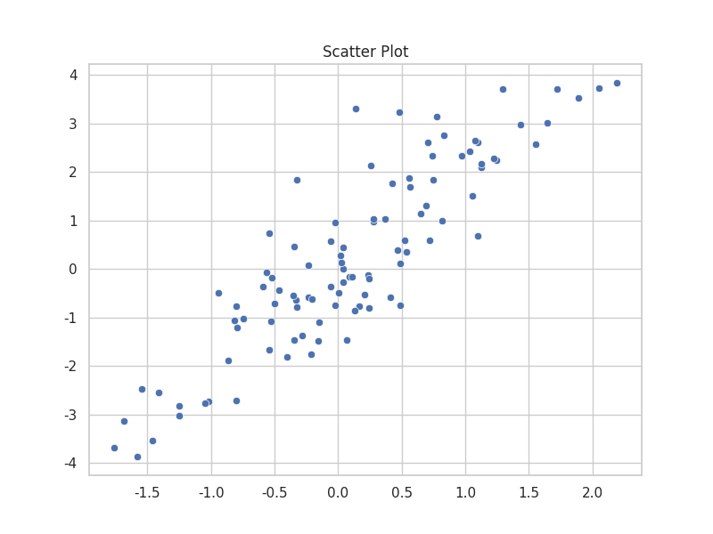
1. Scatter Plot
A scatter plot uses dots to represent values for two different numeric variables, making it ideal for identifying relationships or correlations between them.

Slide 5
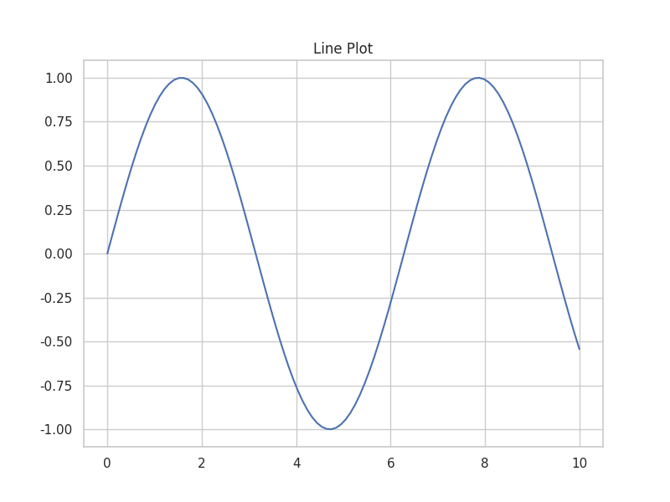
2. Line Plot
A line plot displays information as a series of data points connected by straight line segments, commonly used to visualize trends over a continuous interval or time.

Slide 6
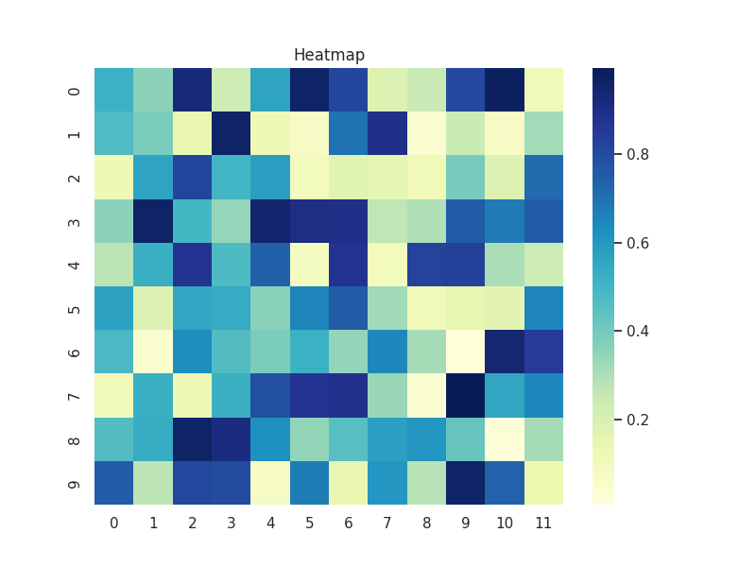
3. Heatmap
A heatmap uses a color-coded matrix to represent data values, allowing for the quick identification of patterns, clusters, or intensity levels across two dimensions.

Slide 7
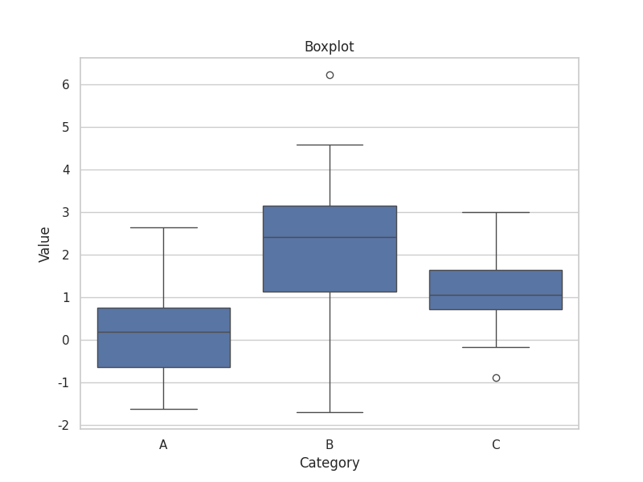
4. Boxplot
A boxplot (or box-and-whisker plot) summarizes the distribution of a dataset based on its quartiles, highlighting the median, spread, and potential outliers.

Slide 8
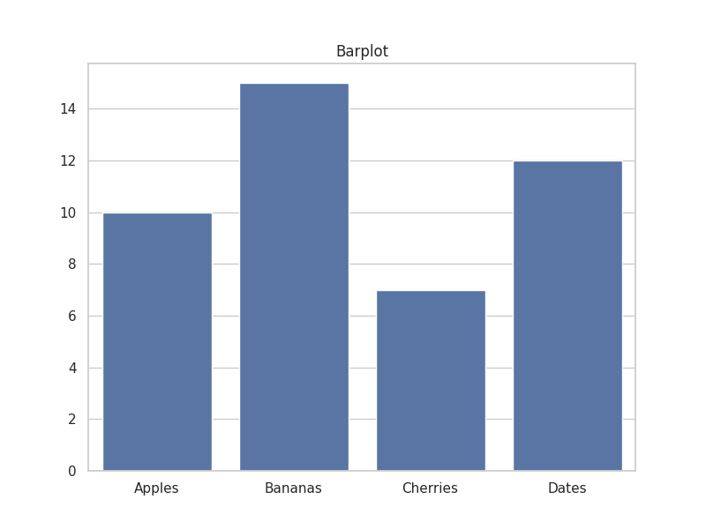
5. Barplot
A barplot presents categorical data with rectangular bars whose heights or lengths are proportional to the values they represent, perfect for comparing different groups.

Slide 9
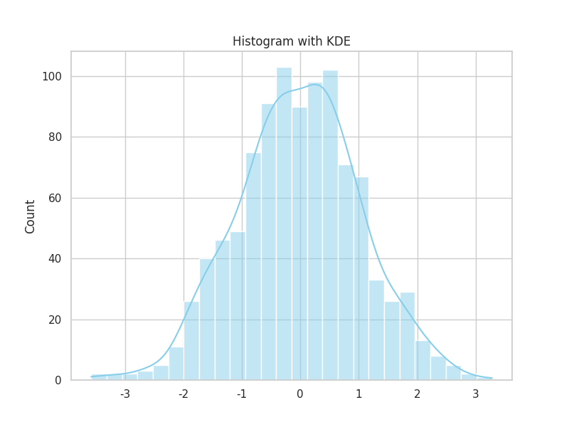
6. Histogram with KDE
A histogram with KDE (Kernel Density Estimate) shows the frequency distribution of a single numeric variable while smoothing the data to reveal the underlying probability density.

Slide 10
Different Categories of Plots in Seaborn
Plots are mainly used to visualize the relationship between variables. These variables can be numerical (like age, salary, marks) or categorical (like gender, department, class). Seaborn classifies plots into the following categories:
1. Relational Plots: These plots help in understanding the relationship between two numerical variables. They are useful for identifying trends or patterns.
2. Categorical Plots: These plots are used when one or both variables are categorical. They help in comparing different groups or categories.
3. Distribution Plots: These plots are used to analyze how data is distributed. They can show the distribution of a single variable (univariate) or the relationship between two variables (bivariate).

Slide 11
4. Regression Plots:
Regression plots are used to visualize the relationship between variables along with a regression line. They help highlight patterns and trends in the data during exploratory data analysis
5. Matrix Plots: Matrix plots display data in a matrix format, often showing relationships between multiple variables at once. They are useful for understanding correlations.
6. Multi-Plot Grids: These plots allow us to create multiple plots of the same type for different subsets of data. This helps in comparing patterns across different groups.

Slide 12
Some Basic Plots Using Seaborn
Histplot: Seaborn’s histplot() function is used to visualize the distribution of a single variable (univariate distribution). It creates a histogram and can also include additional elements like a KDE (Kernel Density Estimate) curve or a rug plot for better understanding of the data distribution.
The histplot() function accepts several arguments, but the most important ones are:
data: The dataset you want to visualize. It can be an array, Pandas Series, or DataFrame. This is a required parameter.
x: Specifies the column to be plotted on the x-axis. If you are using a DataFrame, you can mention the column name.
y: Used when creating a bivariate histogram (two variables). By default, it is set to None, which means a univariate histogram will be created.

Slide 13
bins: Determines the number of intervals (bars) in the histogram. The default value is "auto", which automatically calculates the optimal number of bins.
kde: If set to True, it adds a smooth Kernel Density Estimate (KDE) curve along with the histogram. By default, it is False, so only the histogram is displayed.
import numpy as np
import seaborn as sns
sns.set(style="white")
//(A seed is a starting number used by the random number generator.)
# Generate a random univariate dataset
rs = np.random.RandomState(10)
d = rs.normal(size=100)
//(Create a random number generator with seed 10, then generate 100 bell-curve random numbers and store them in d.)
# Plot a simple histogram and kde
sns.histplot(d, kde=True, color="m")

Slide 14
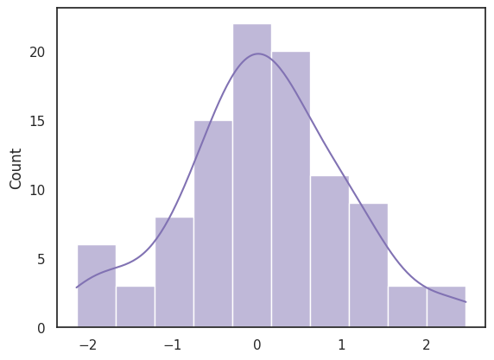

Slide 15
Distplot
Seaborn’s distplot() function is used to visualize the distribution of a single variable (single feature). It displays a histogram and can also include additional elements such as a KDE (Kernel Density Estimate) curve and a rug plot to better understand how the data is distributed.
Note: In newer versions of Seaborn, distplot() is deprecated and replaced by histplot() and kdeplot().
The function takes several parameters, but the most important ones are:
a: The array, list, or Pandas Series that contains the data you want to visualize. This is a required parameter.
bins: Specifies the number of intervals (bars) in the histogram. By default, it is set to "auto", which automatically selects the optimal number of bins.

Slide 16
kde: Determines whether to display the KDE (smooth density curve) along with the histogram. By default, it is set to True, so the KDE curve is shown.
hist: Controls whether to display the histogram. By default, it is set to True, meaning the histogram will be plotted along with the KDE curve (unless changed).

Slide 17
import numpy as np
import seaborn as sns
sns.set(style="white")
# Generate a random univariate dataset
rs = np.random.RandomState(10)
d = rs.normal(size=100)
# Define the colors to use
colors = ["r", "g", "b"]
//(hist_kws → controls histogram (red, transparent bars) kde_kws → controls KDE curve (green, thicker line) rug_kws → controls rug plot (blue data-point marks) bins=10 → 10 histogram bars kde=True → show smooth curve hist=True → show histogram rug=True → show data-point ticks on x-axis.)
# Plot a histogram with multiple colors
sns.distplot(d, kde=True, hist=True, bins=10,
rug=True,hist_kws={"alpha": 0.3,
"color": colors[0]},
kde_kws={"color": colors[1], "lw": 2},
rug_kws={"color": colors[2]})

Slide 18
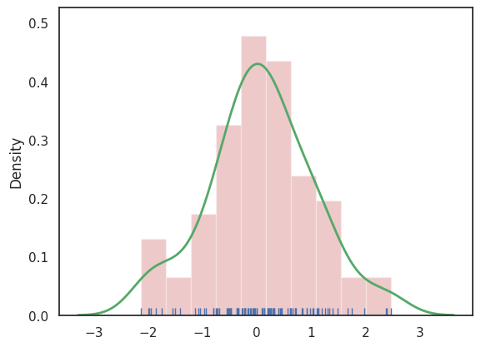

Slide 19
Lineplot
A line plot is one of the simplest and most commonly used plots in Seaborn. It is mainly used to represent data that changes continuously over a period of time.This plot is especially helpful for visualizing time-based data (time series), where values are shown in a continuous sequence. It helps us easily understand trends, patterns, and changes in the data over time.
import seaborn as sns
import matplotlib.pyplot as plt
sns.set(style="dark")
fmri = sns.load_dataset("fmri")
# Plot the responses for different\
# events and regions
sns.lineplot(x="timepoint",
y="signal",
hue="region",
style="event",
data=fmri)
plt.show()

Slide 20
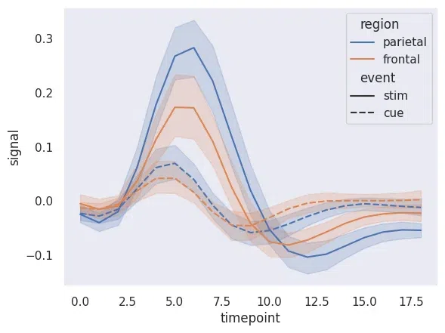

Slide 21
Lmplot
Lmplot is a basic plot in Seaborn that is used to show the relationship between two variables. It displays the data points on a two-dimensional graph along with a line that represents a linear regression model.
In this plot, the x value is shown on the horizontal axis and the y value is shown on the vertical axis. The regression line helps to clearly understand the trend between the two variables.
import seaborn as sns
sns.set(style="ticks")
# Loading the dataset
df = sns.load_dataset("anscombe")
# Show the results of a linear regression
sns.lmplot(x="x", y="y", data=df)

Slide 22
